Slide 1

Thunderbots@Home
Software Overview
- Devon Ash

Slide 2
Goal of Thunderbots Software
Apply State-of-the-Art Solutions
Undergraduate Exposure to R&D
Build a re-usable research platform

Slide 3
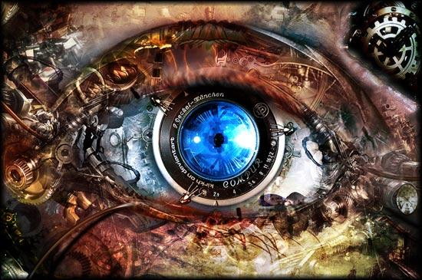
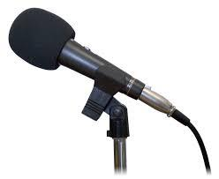
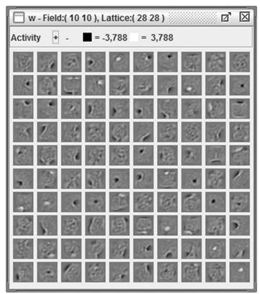
Research Areas
Currently,
Faces, People, Objects, Obstacles, Scenes
Later, Machine Learning..
Speech Recognition, Localization, Synthesis, and NLP
Deep Learning, Unsupervised Feature Learning, Generative Models

